Slide 1
SNA ACTIVITIES 2023-2024

Slide 2
Independence day

Slide 3
Rakshabandhan celebration

Slide 4
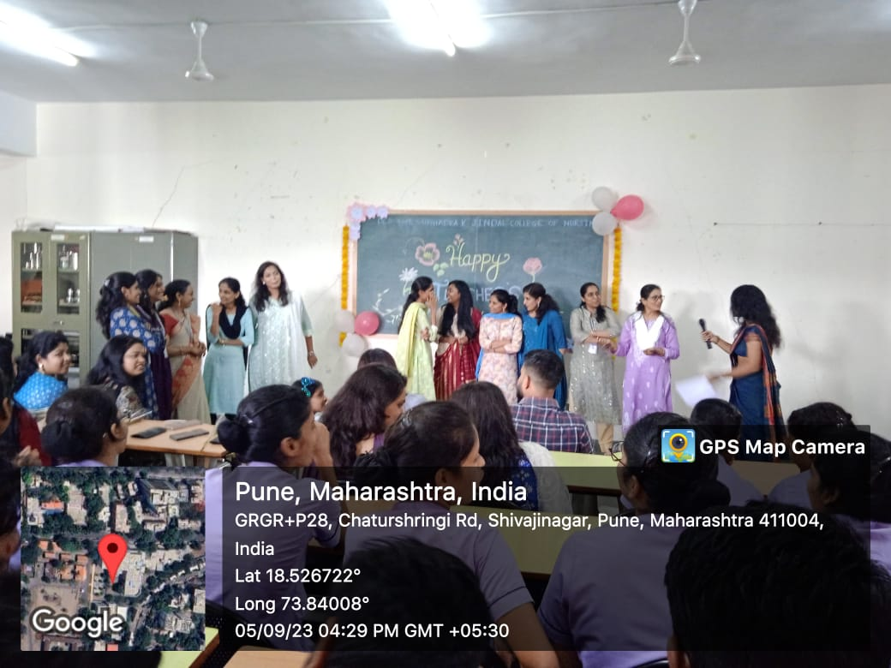
Teacher’s day

Slide 5
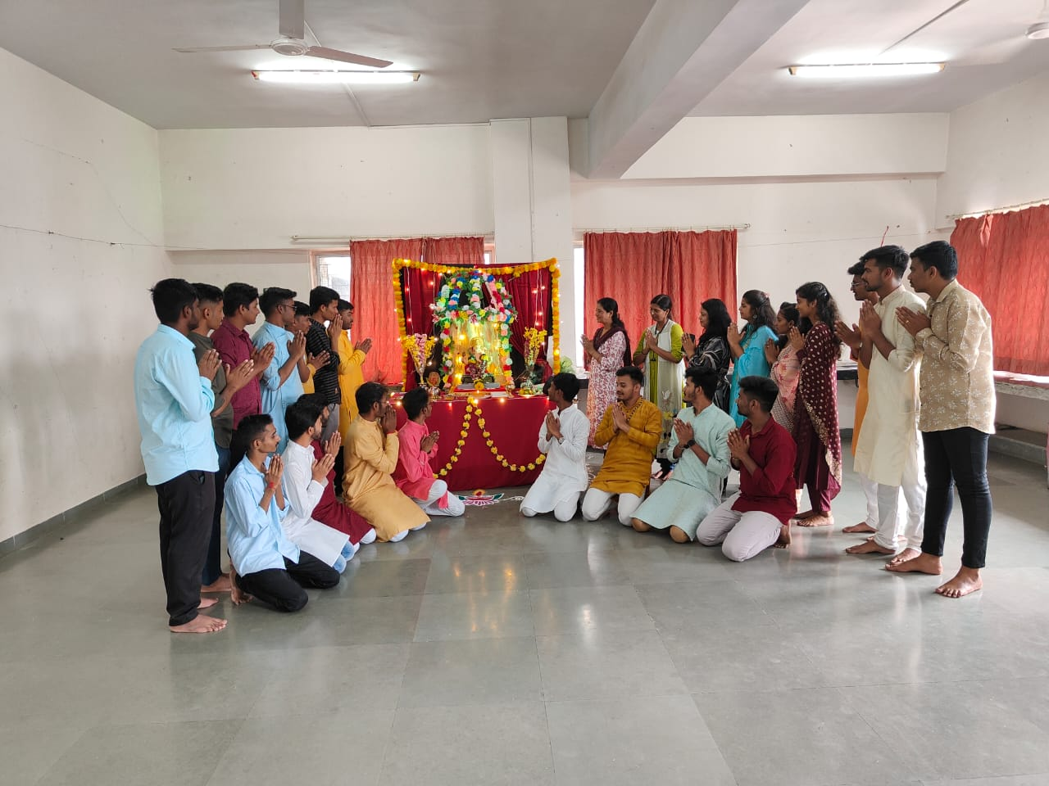
Ganpati celebration

Slide 6
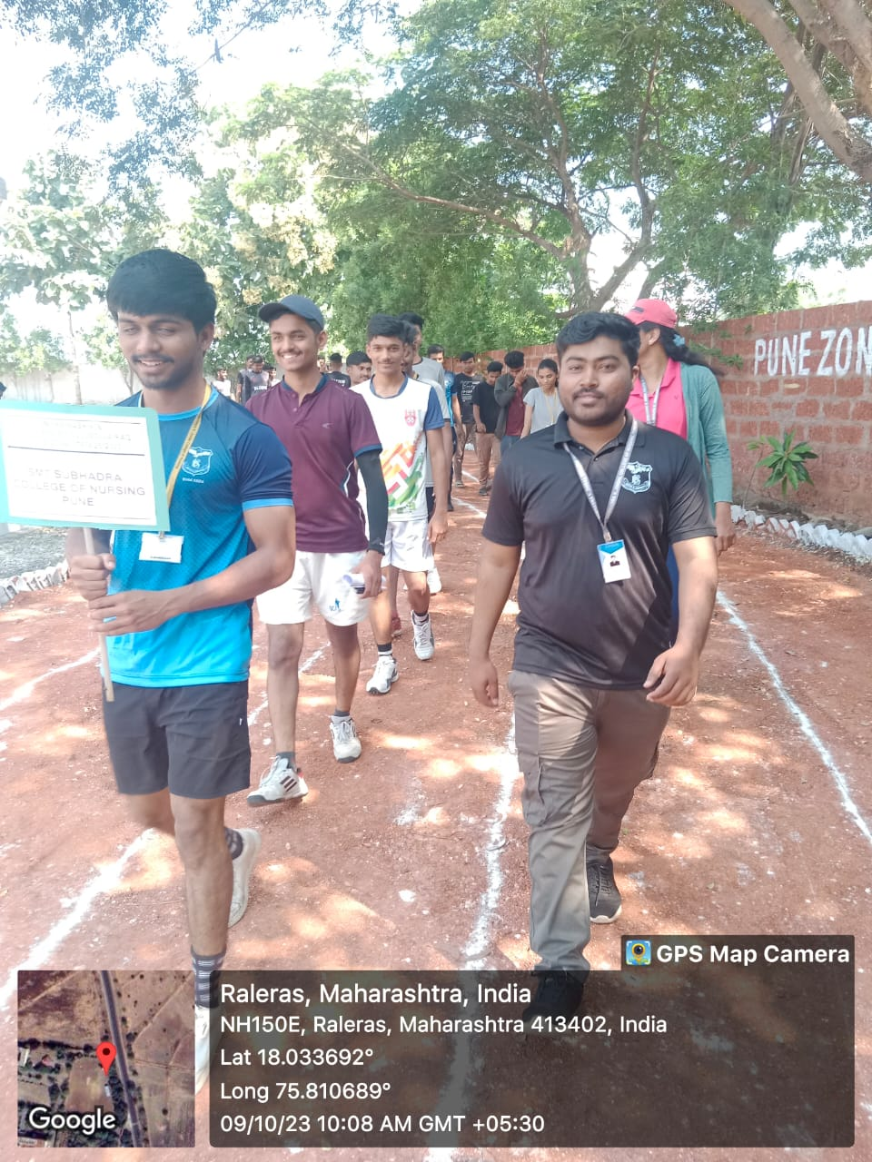
MUHS Krida Mahotsav

Slide 7
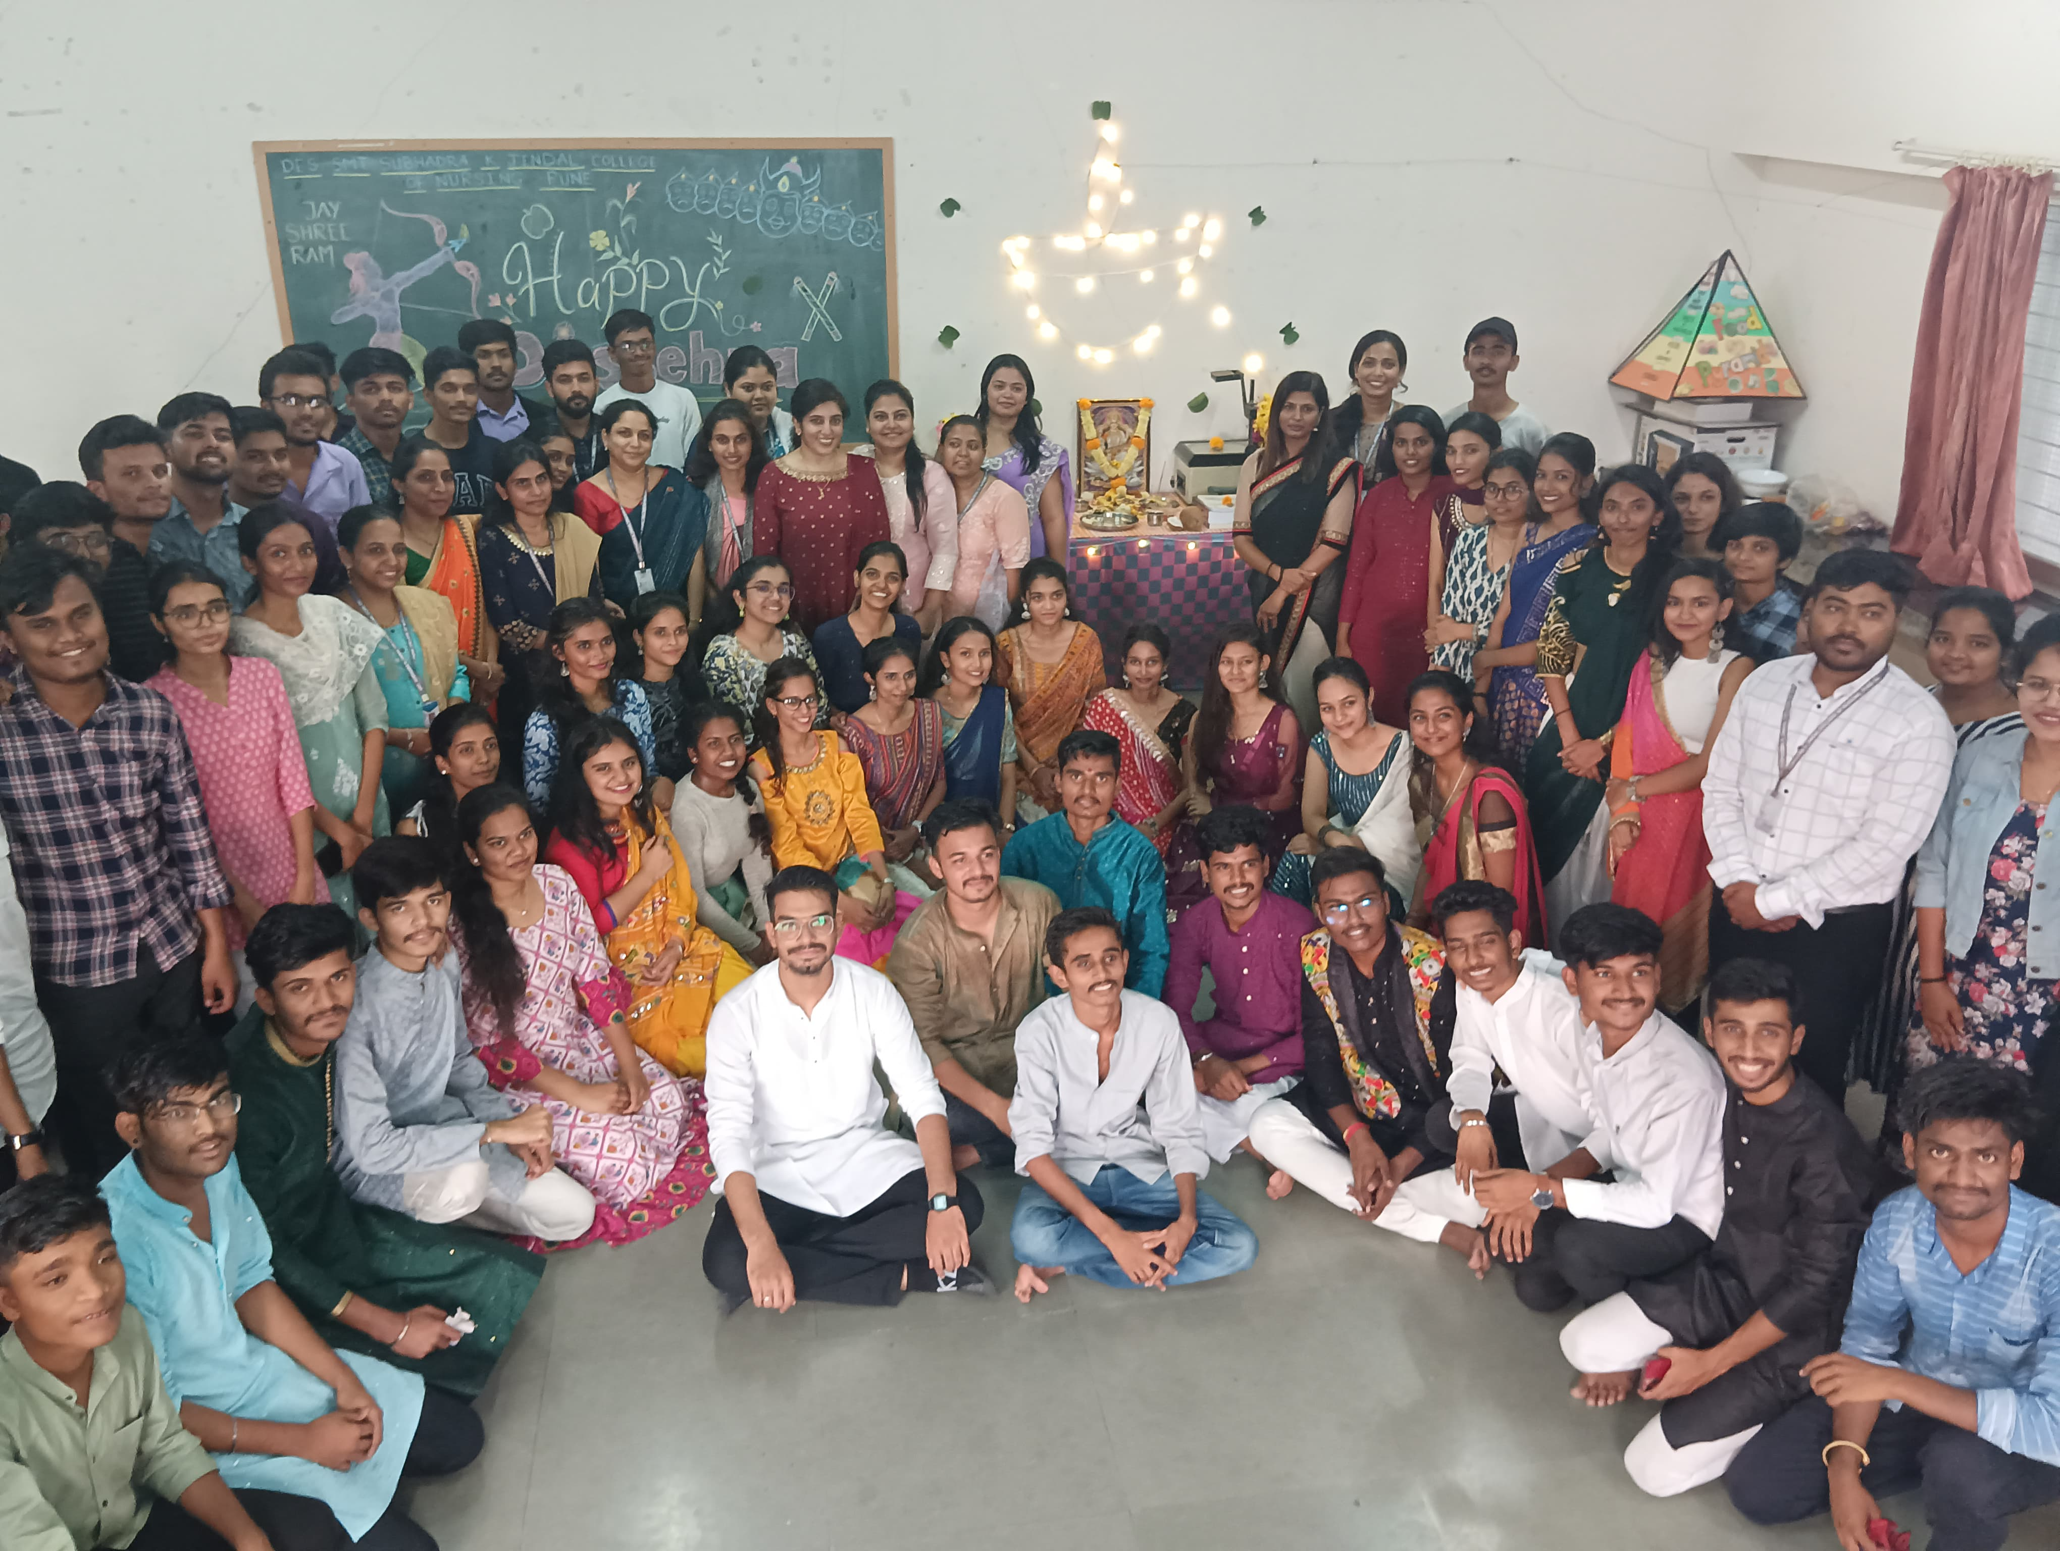
Dussehra Celebration

Slide 8
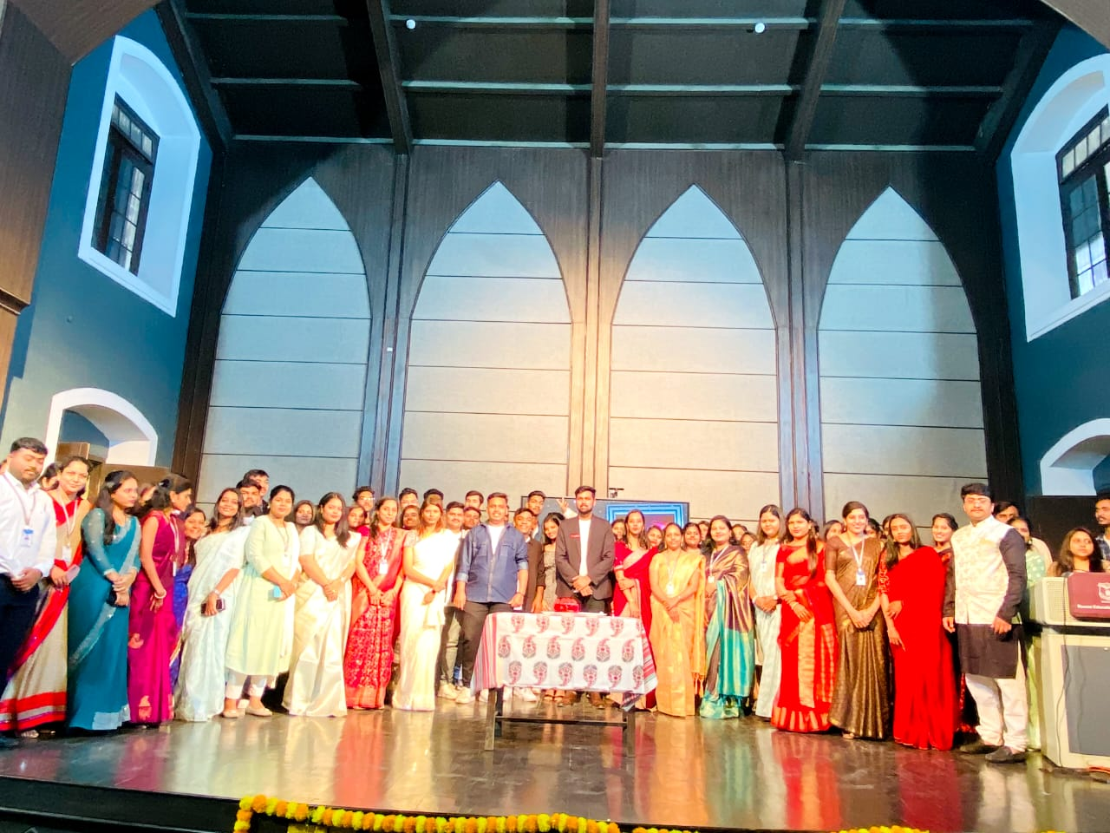
Christmas Celebration

Slide 9
New Year Celebration

Slide 10
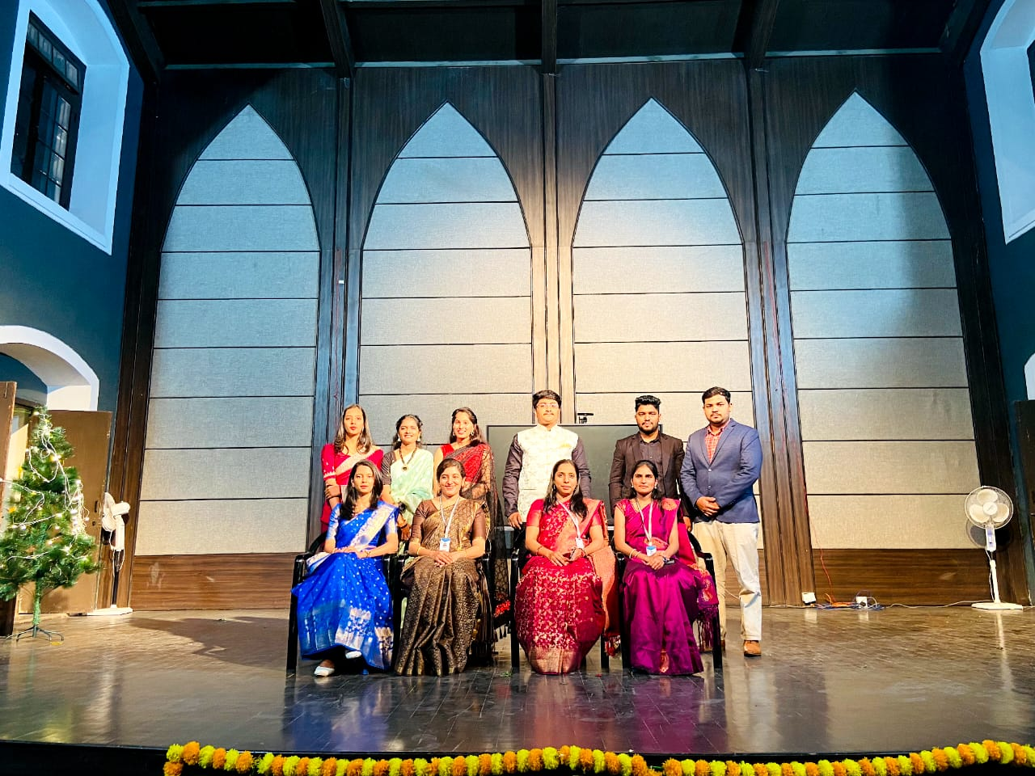
Freshers party

